Slide 1
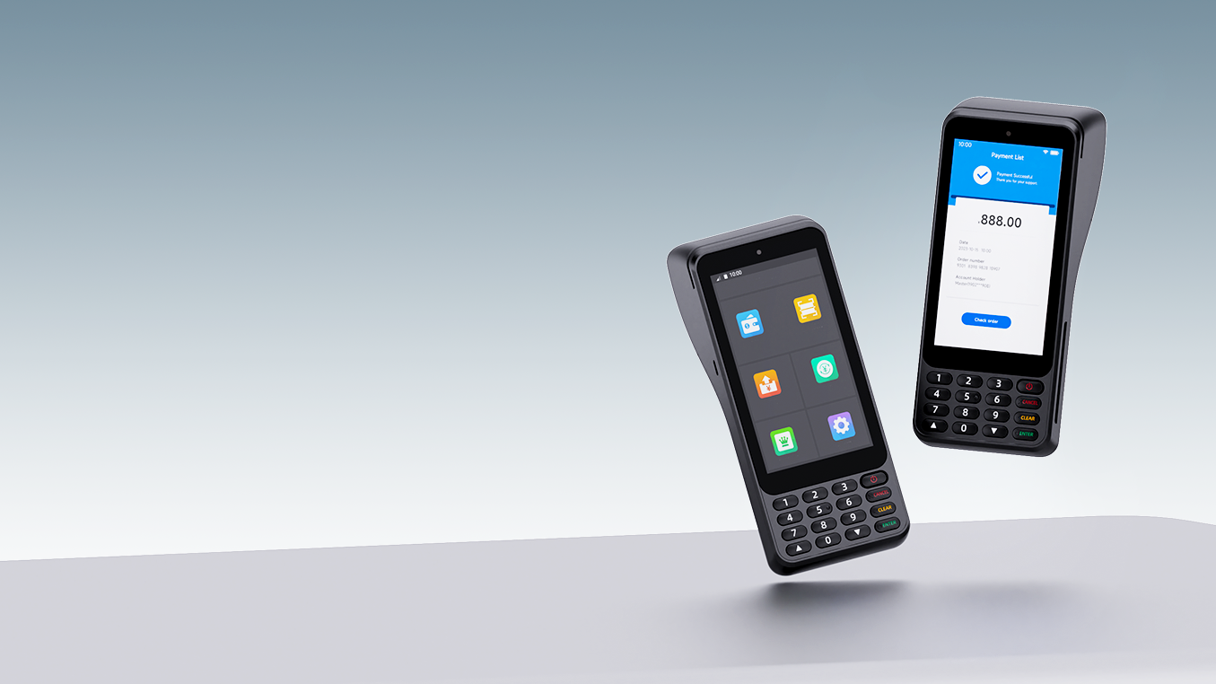
NEW9010
Smart POS Terminal
Advanced leadership, a combination of the most modern and classic.
www.newpostech.com

Slide 2
High Performance
NEW9010 is based on the ARM Cortext-A53 Quad Core, a processor with the speed of 2.0GHz, and with increased memory 2GB RAM + 16GB FLASH. Using the latest Android 12 version. NEW9010 is very premium on its performance.

Slide 3
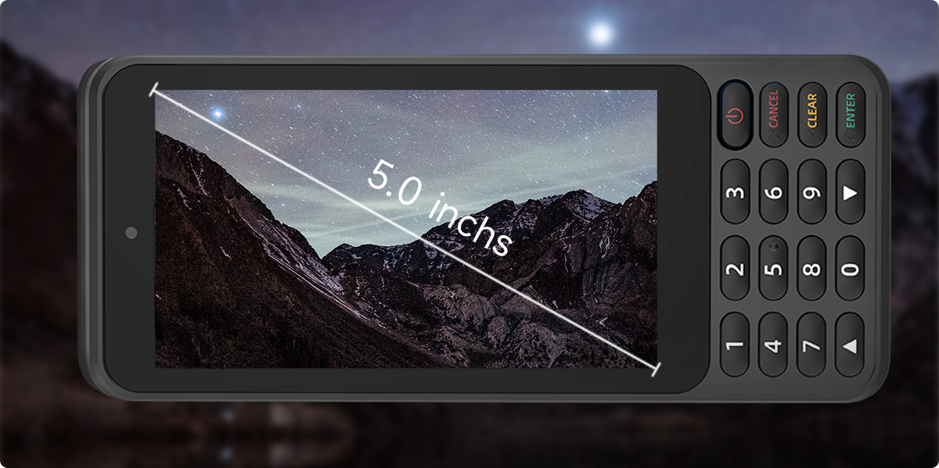
Bigger Screen
NEW9010 is the portable POS terminal with a 5.0” big screen to deliver extraordinary visual and operation experience.

Slide 4
Physical PIN
input keypad
Entering amounts and passwords is more convenient and efficient

Slide 5
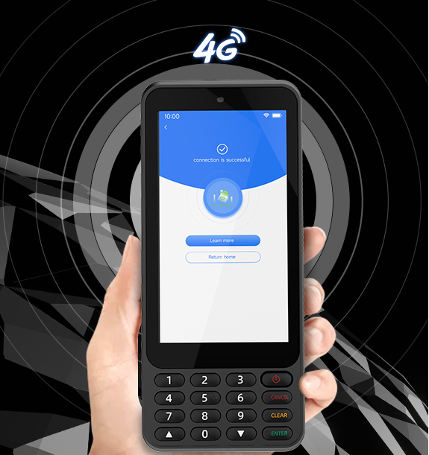
Use NEW9010
Anywhere
NEW9010 adopts Qualcomm chipsets and powerful communication module, to ensure fast and stable communication and strong network adaptability.

Slide 6
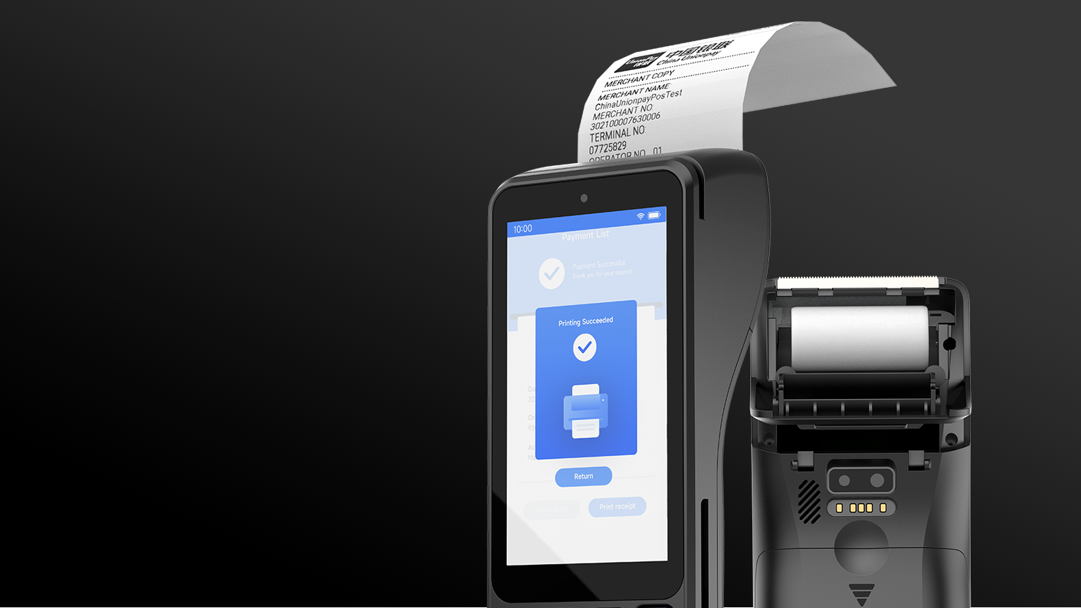
Printer speed greater than 90mm/s
Equipped with a metal paper cutter,
with long service life and smooth paper tearing.

Slide 7
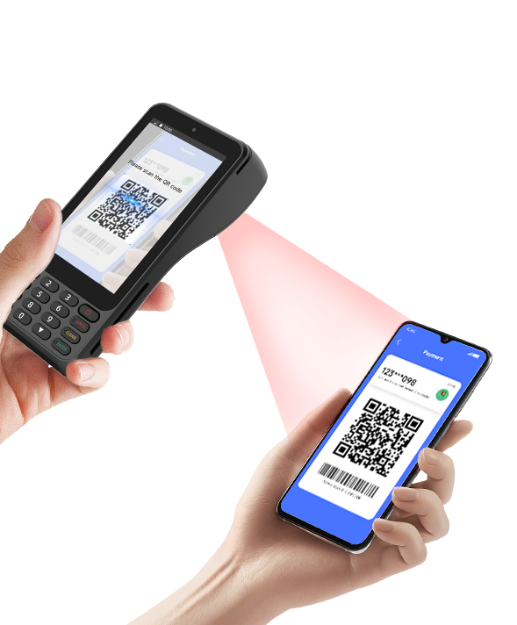
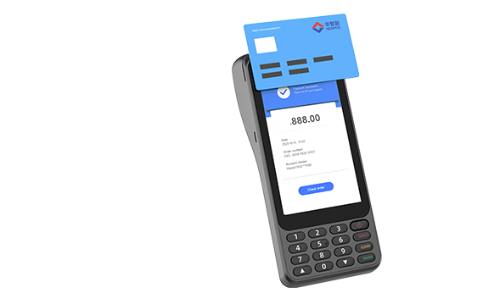
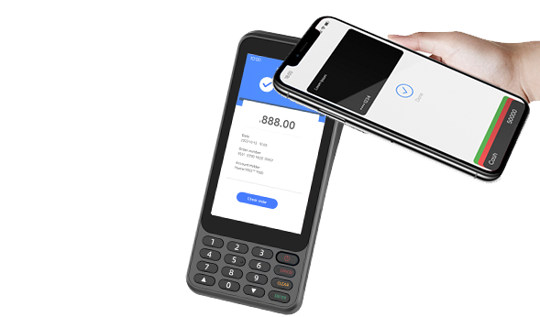
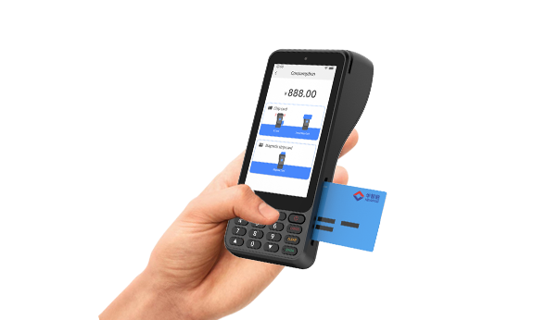
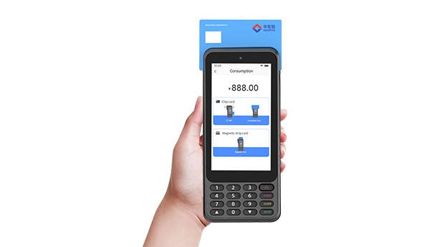
Payment Methods
NEW9010 accepts payments of magnetic stripe cards, IC cards, contactless/NFC and 1D&2D codes.
QR Code
Contactless Card
NFC
IC Card
Magnetic Card

Slide 8
NEW9010 Specifications
CPU | Cortex Quad-core A53, 2.0GHz
Memory | 2GB RAM+8GB ROM 2GB RAM+16GB ROM(optional） 3GB RAM+32GB ROM (optional）
OS | Asmart Os(Based on Android 12)
Display | 5" HD, IPS, 720 *1280Pixels
Buttons | 10 alphanumeric keys 5 function keys 1 power switch key
Card Reader | Magnetic Card Reader Smart Card Reader Contactless Card Reader
Printer | High-Speed Thermal printer Paper Width: 58mm Diameter: 40mm
Power | Input: 100-240VAC,50/60Hz Output: 5V DC, 2A
Camera | Rear: 5 MP(optional) Reads 1D&2D Codes
Communication | 4G/3G/2G；WIFI 2.4G&5G；Bluetooth 5.0
Location | GPS, GLONASS, BEIDOU
Card Slots | 2 x SIM + 2 x SAM ESIM（optional）
Battery | Rechargeable Li-ion Battery 7.2V/3200mAh(optional) 7.2V/2600mAh
Peripheral Ports | 1 x Type C USB
Working environment | Temperature: 09C~50°℃(32°F~122°F) Humidity: 10%~90%(non-condense)
Physical | 190mm x 80mm x 57.4mm；450g(including battery)
Storage environment | Temperature: -20℃℃~60℃(-4°F~140°F) Humidity: 5%~95%(non-condense)
Certifications | PCI PTS 6.x、EMV L1&L2、 EMV CL L1、QUICS、TQM、 Visa PayWave、MasterCard PayPass、 American Express、Discover D-PAS、 Anatel、ABECS、CE.

