Slide 1
NEW9310Pro
Smart POS terminal
Leading the new fashion of payment
www.newpostech.com

Slide 2
Performance and experience
both leap to extraordinary levels
A more powerful Quad-core 2.0GHz processor keeps transactions running seamlessly and faster than ever before.

Slide 3
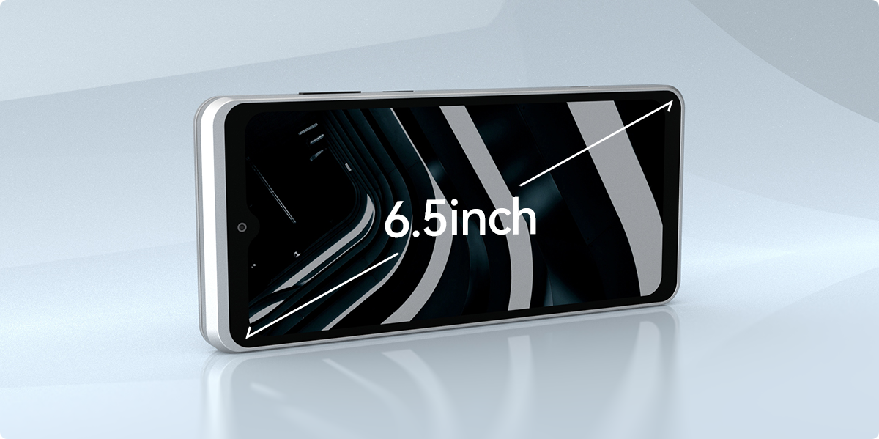
Splendid Large
Screen Display
The 6.5-inch touch screen adjusts its brightness based on current lighting conditions and provides you the ultimate visual experience in any environments.

Slide 4
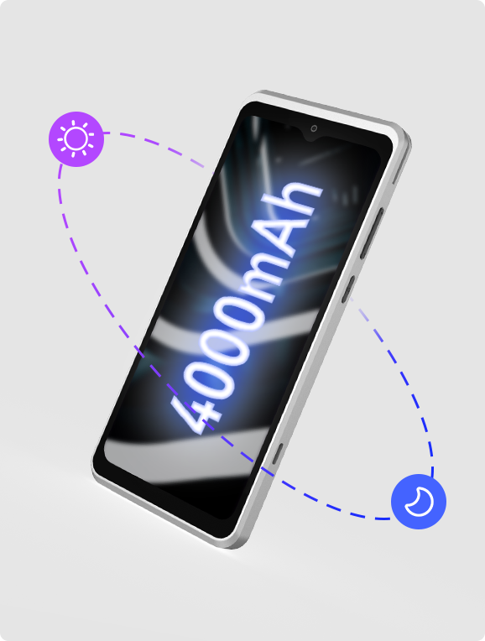
Extra large battery
4000mAh From morning to night, worry-free battery life
*The description from morning to night comes from NEWPOS laboratory and is calculated based on the user's normal transaction usage model.

Slide 5
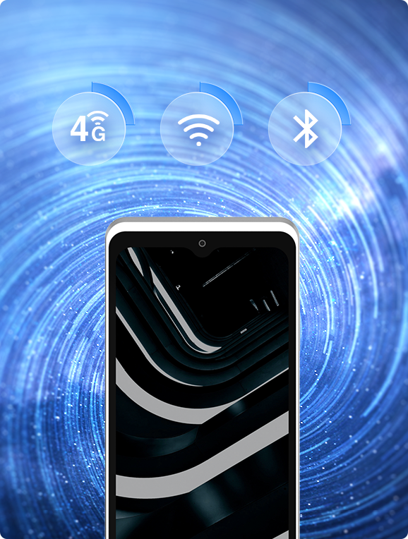
All Solutions For Full Connection
With the help of solutions for full connection, you could make payment or process data rapidly and securely on the spot through: 2G/3G/4G, Wi-Fi, Bluetooth.

Slide 6
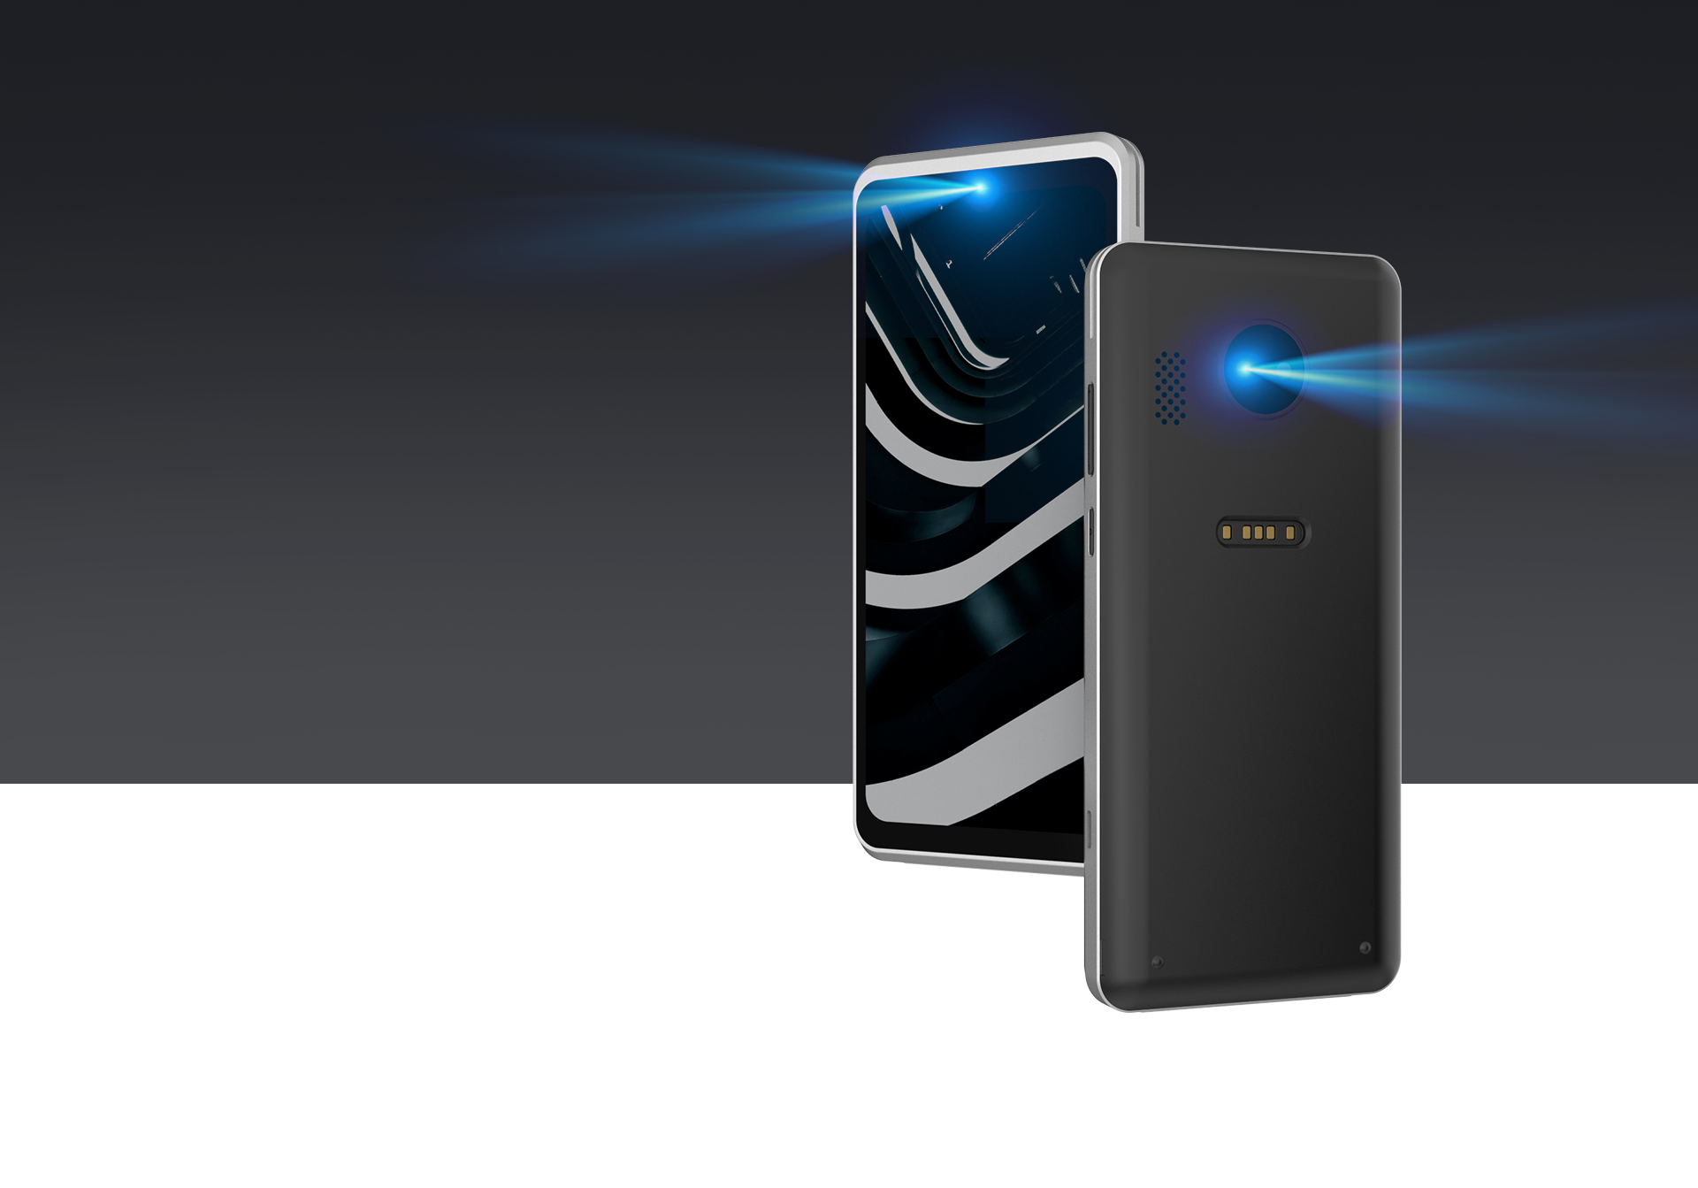
Dual Camera
2MP Front camera and 13MP autofocus rear camera catch every detail of the codes, and makes payment more rapid and safer.

Slide 7
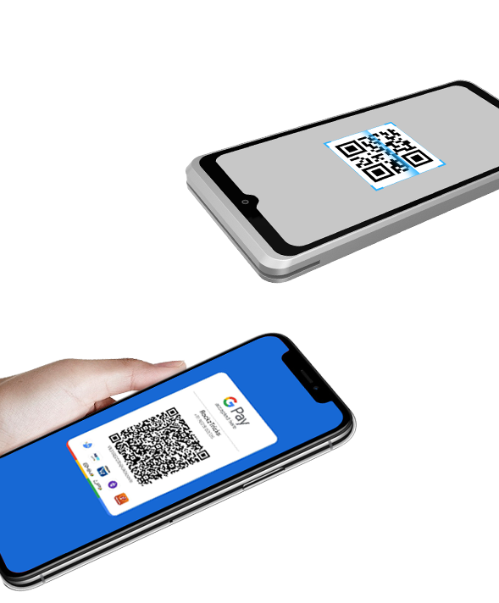
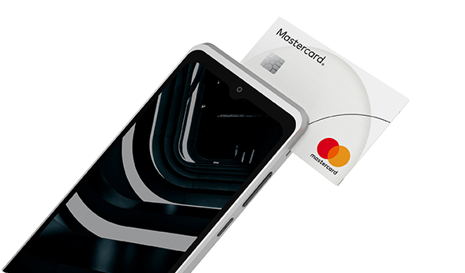
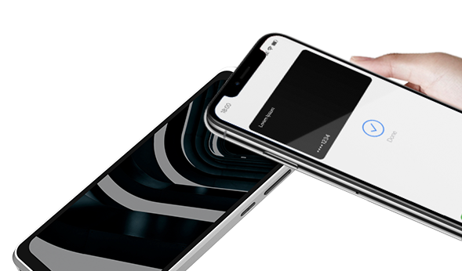
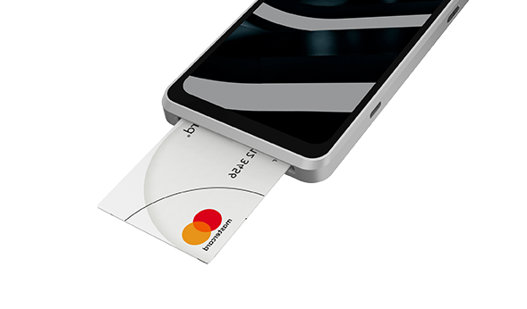
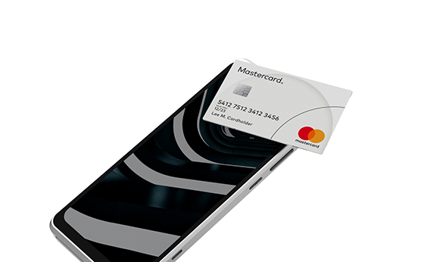
Supporting All Payments
It supports various payment methods, such as magnetic card, IC card, contactless transaction and code scanning transaction. A machine can be used for various forms, making collection simple.
QR Code
Magnetic
Card
NFC
IC Card
Contactless
Card

Slide 8
NEW9310Pro Specifications
CPU | Quad-core Cortex-A53
Memory | 2GB RAM+8GB ROM 2GB RAM+16GB ROM (optional) TF card up to 512GB
OS | Asmart
Display | 6.5"HD 720 x1600 Pixels
Communication | 4G\3G\2G WiFi(802.11 a\b\g\n)2.4G&5G Bluetooth 5.0
Card Readers | Magnetic Card Reader Smart Card Reader Contactless Card Reader
Location | GPS/BEIDOU/GLONASS\AGPS
Camera | Front: 2 MP (optional) Rear: 5 MP (optional)13MP (optional) with fill light,support 1D & 2D code payment
Peripheral Ports | 1xType-C USB(OTG) 1xPogo pin interface support expansion base(optional)
Wight | 280g(Indluding battery)
Card Slots | 2 x Nano SIM+1x TF 2 x Nano SIM+1xSAM+1xTF(optional) 1 x eSIM(optional) Choose between eSIM and SIM card Slots
Battery | Rechargeable Li-ion Battery 3.85V/4000mAh
Power | Input:100-240V AC,50/60Hz Output: 5V DC,2A
Keypad | Secure virtual keypad for PIN entry 1*Power button 2*Volume:+\-
Certifications | PCI PTS 6.X, EMVL1&L2, EMV CTLS L1, Quick pass, Visa PayWave, MasterCard PayPass, American Express, Discover D-PAS, JCB, Felica, VCCI-b, JATE, MIC, TQM, RoHS
Working environment | Temperature: 0°C~50°C(32°F~122F) Humidity: 5%~90%(non-condense)
Storage environment | Temperature: -20°C~60°C(-4F~140°F) Humidity: 5%~95%(non-condense)
Size | 173.4mm*77.5mm*16.3mm(L*W*H)

