Slide 1
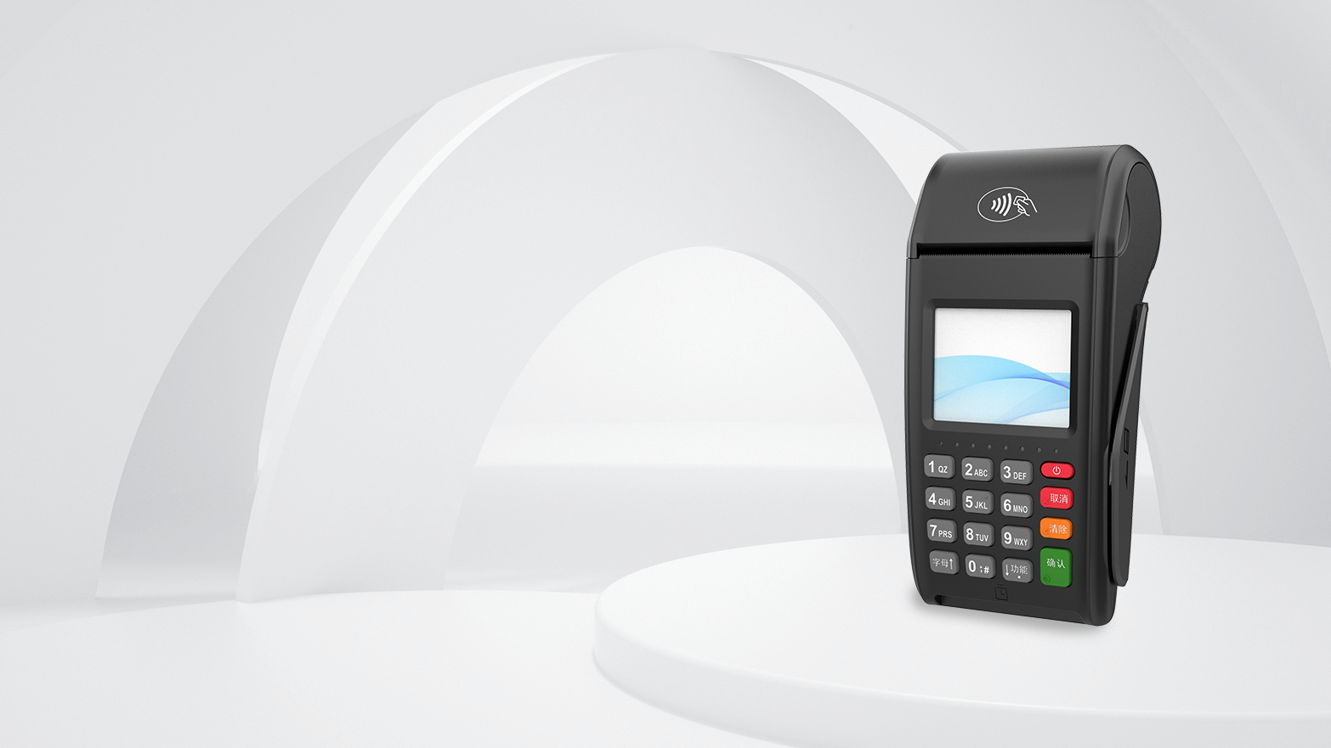
NEW7220
Wireless POS Terminal
Powerful performance, Simplicity with sophistication
www.newpostech.com

Slide 2
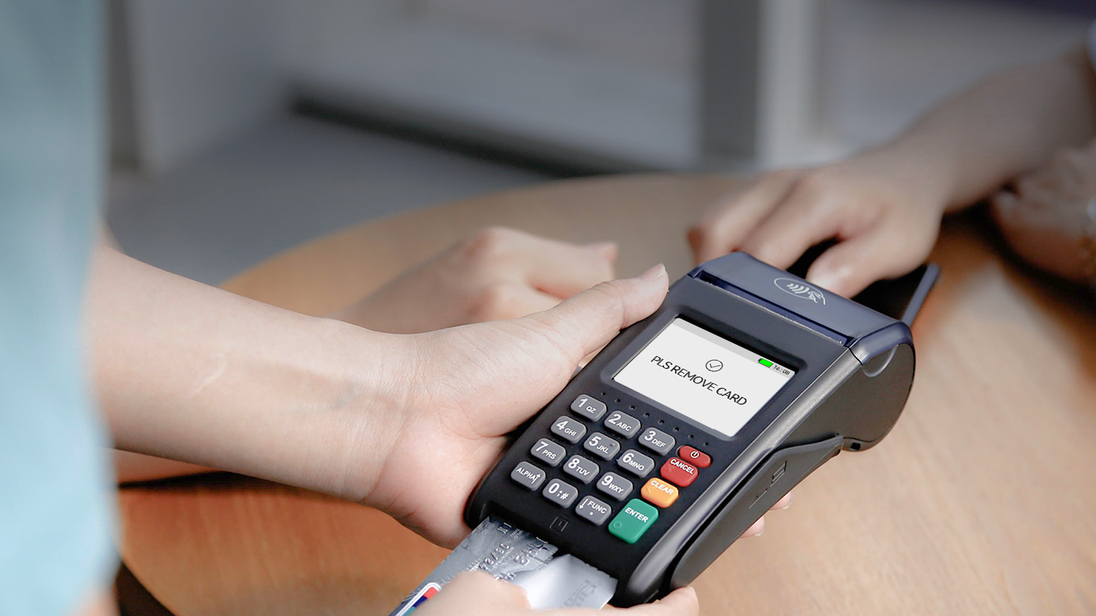
2.4" Colour Display
NEW7220 with a TFT touchscreen display, comes with signature capture and support animation and image display, smooth display, easy to customize the exclusive interface.

Slide 3
LONG-LASTING
BATTREY
NEW7220 can make 300 transactions and has a standby time of up to 22 days.Because we use the industry leading system architecture and 3.6V/2600mAh large rechargeable Li-ion battery.

Slide 4
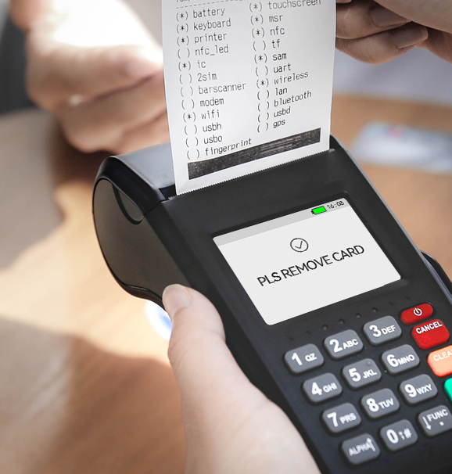
Integrated
printing function
58 mm high speed integrated thermal printer, convenient for printing receipts anytime and anywhere.

Slide 5
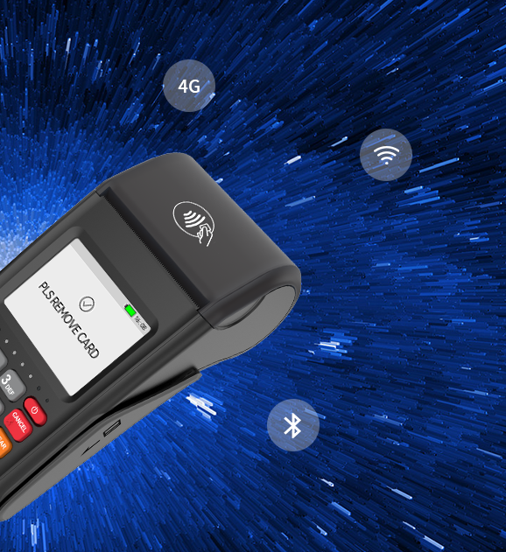
Full Internet
communication
With a full range of communication of WiFi 4G 3G 2G LAN, NEW7220 is powerful, customizable, scalable setting up forward-thinking merchants for years to come.

Slide 6
Built-in
password keyboard
Supports MK/SK key management mode, supports RSA, AES, and SM2-SM4 algorithms, providing secure and reliable payment.

Slide 7
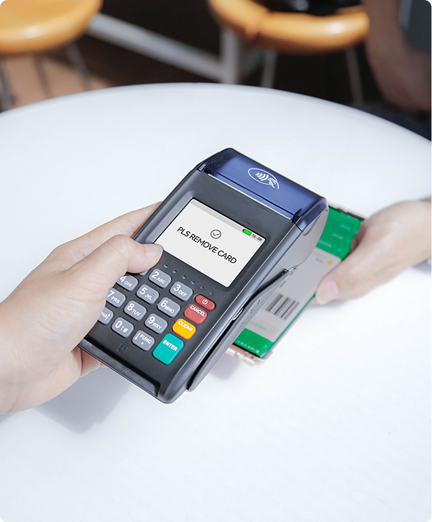
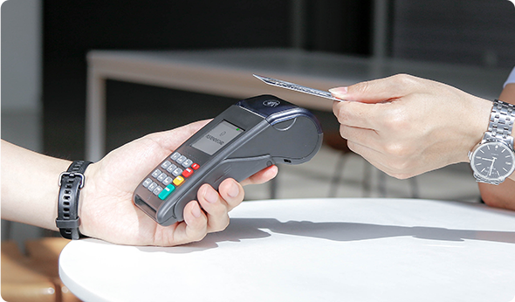
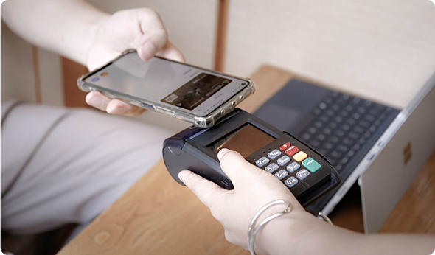
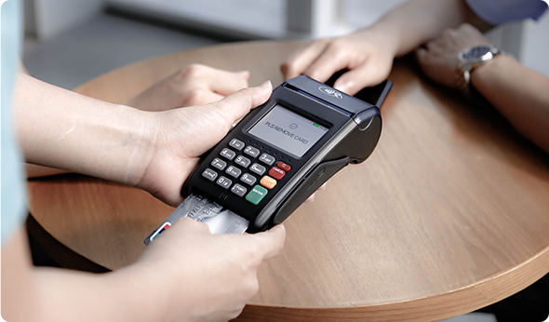
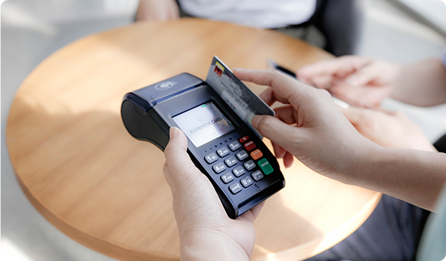
Supporting All Payments
It supports various payment methods, such as magnetic card, IC card, contactless transaction and code scanning transaction. A machine can be used for various forms, making collection simple.
1D/2D QR
NFC Contactless
Apple Pay & Google Pay
IC Card
Magnetic card

Slide 8
NEW7220 Specifications
CPU | ARM Cortex A7 1.2GHz
Memory | FLASH:256MB；RAM: 256MB
Display | 2.4"LCD.320X240 pixels Resistive Touch Screen
Keypad | 10 alphanumeric keys 5 function keys 1 power switch key
Card Reader | Magnetic Card Reader Smart Card Reader Contactless Card Reader
Scanning | Optional, Support 1D & 2D Code scanning
Card Slots | 1×SIM+1×SAM 2×SIM+2×SAM(optional)
Communication | 4G(LTE)/3G(WCDMA)/2G(GPRS) Optional WiFi(24GHz) Optional LAN(Expansion Dock)
Peripheral Ports | 1 × Type-C USB2.0 Device
Printer | High-Speed Thermal Printer Paper Width: 58mm Diameter:40mm
Adapter/ Power | Input: 100~240VAC,50Hz/60Hz Output:5V DC 1A
Battery | Rechargeable Li-ion battery 3.6V/2600mAh
Dimensions | L×W×H (mm):163×79×58
Audio | 1 × Buzzer
Working Environment | Temperature:0°C~50°C(32°F~122°F) Humidity:10%~90%(non-condense)
Storage Environment | Temperature:-20°C~60°C(-4°F~140°F) Humiditv:5%~95%(non-condense)
Weight | 320g (Including Battery)
Certifications | PCI PTS 6.XEMV Level1&2 ,EMV ContactlessL1,Pavpass Pavwave.American ExpressPay, Discover D-PAS,CE,TOM,RoHS

