Slide 1
NEW9310
Smart POS Terminal
Large Screen Design, Inspiring the Future
www.newpostech.com

Slide 2
Powerful Performance, Superior Experience
A more powerful Quad-core 1.4G processor makes transactions to run seamless and faster than ever.

Slide 3
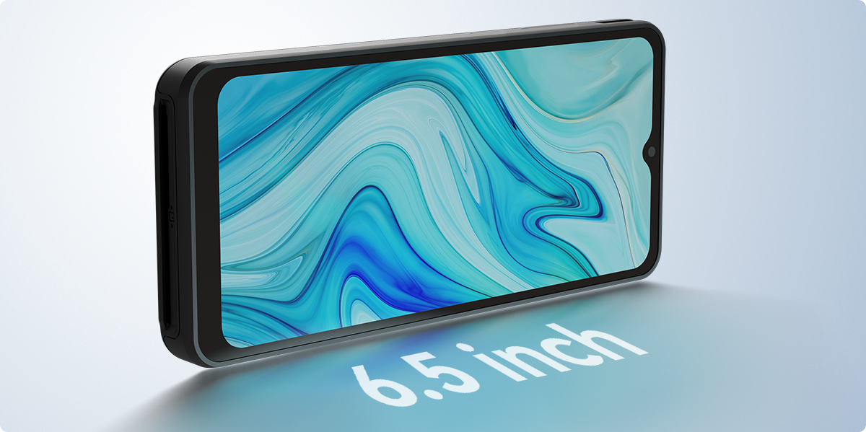
Splendid Large
Screen Display
The 6.5-inch touch screen adjusts its brightness based on current lighting conditions and provides you the ultimate visual experience in any environments.

Slide 4
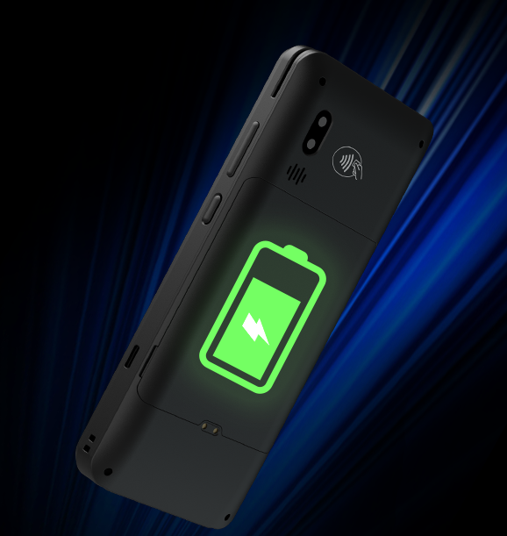
Long Battery Life
The rechargeable 3000mAh/3.8V battery ensures the NEW9310 keeps transacting smoothly a full day with a single charge.

Slide 5
All Solutions
For Full Connection
With the help of solutions for full connection, you could make payment or process data rapidly and securely on the spot through: 2G/3G/4G, Wi-Fi，Bluetooth.

Slide 6
Dual Camera
2MP Front camera and 5MP autofocus rear camera catch every detail of the codes, and makes payment more rapid and safer.
2MP
5MP
Front
Rear

Slide 7
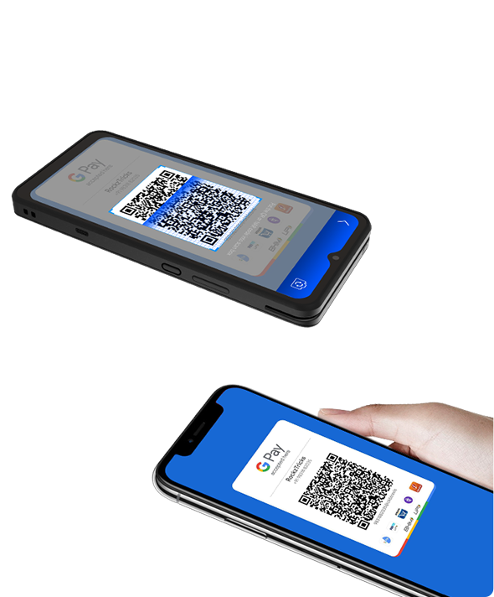
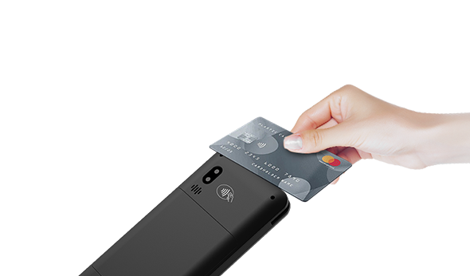
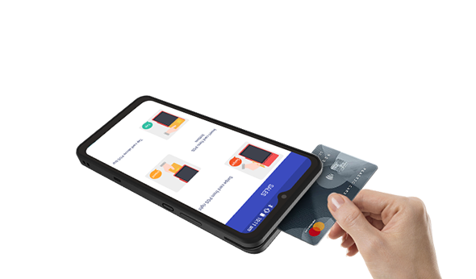
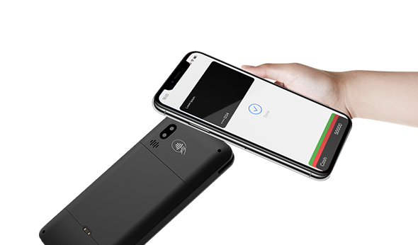
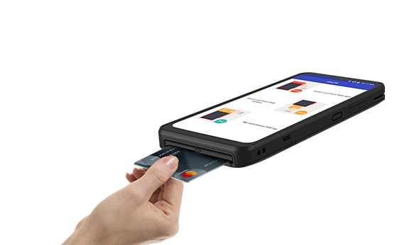
Supporting All Payments
It supports various payment methods, such as magnetic card, IC card, contactless transaction and code scanning transaction. A machine can be used for various forms, making collection simple.
QR Code
Contactless Card
Magnetic Card
NFC
IC Card

Slide 8
NEW9310 Specifications
CPU | Quad-core Cortex-A53
Memory | 1GB RAM+8GB ROM 2GB RAM+16GB ROM (optional)
OS | Android 10
Display | 6.5"HD 1600 x 720 Pixels 1280 x 576 Pixels(Optional)
Communication | 4G，WiFi，GPS，Bluetooth
Card Readers | Magnetic Card Reader Smart Card Reader Contactless Card Reader
Location | GPS/BEIDOU/GLONASS
Camera | Front: 2 MP (optional) Rear: 5 MP (optional) Reads 1D & 2D Codes
Buttons | Power button Volume +/-
Peripheral Ports | 1xType-C USB
Card Slots | 2xSIM +1xSAM 2xSIM +2xSAM (optional)
Battery | Rechargeable Li-ion Battery 3.8V/3000mAh
Power | Input:100-240VAC,50/60Hz Output: 5VDC,1A
Dimensions | LxWxH(mm): 167.5x76.5x16.8
Certifications | PCI PTS 6X. , EMV L1&L2, EMV CL L1, Quick pass, TQM,CE, RoHS, Visa PayWave, MasterCard PayPass, AMEX
Working environment | Temperature: 0°C~50°C(32°F~122F) Humidity: 10%~90%(non-condense)
Storage environment | Temperature: -20°C~60°C(-4F~140°F) Humidity: 5%~95%(non-condense)

