Slide 1
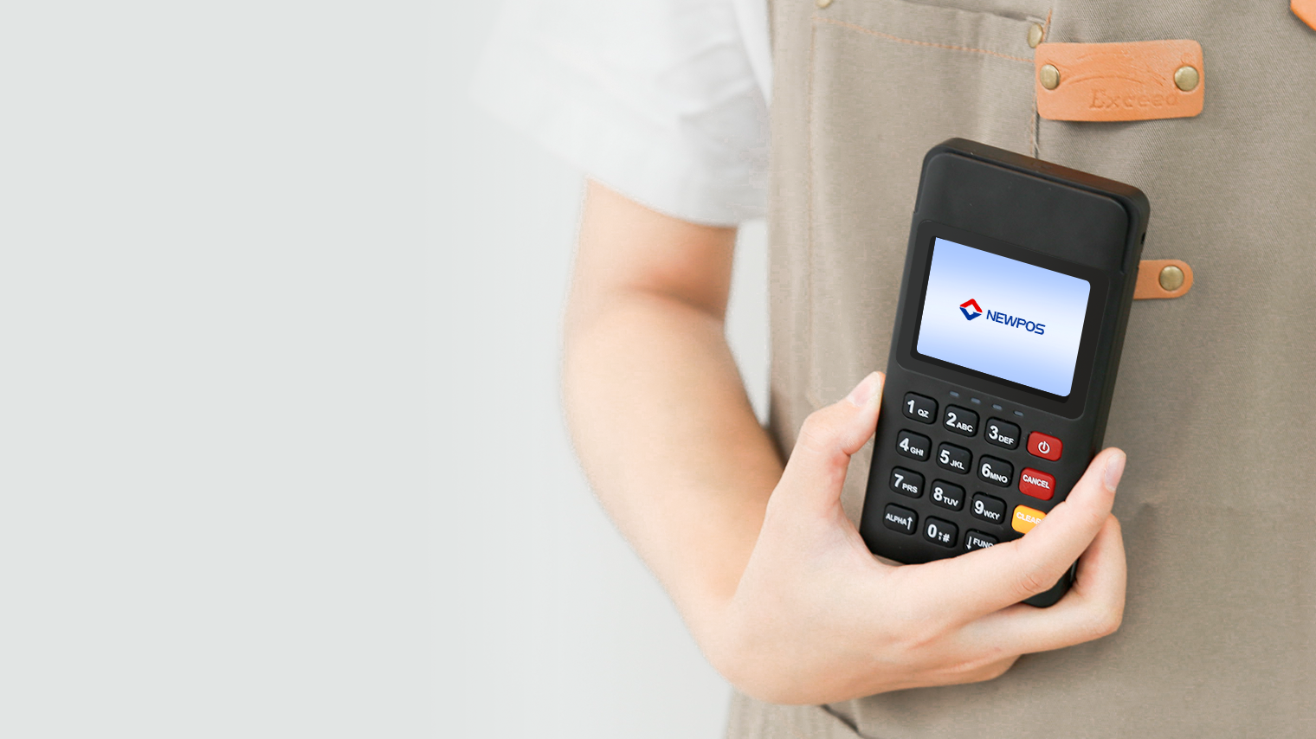
NEW6260
Wireless POS Terminal
Make payments easier
www.newpostech.com

Slide 2
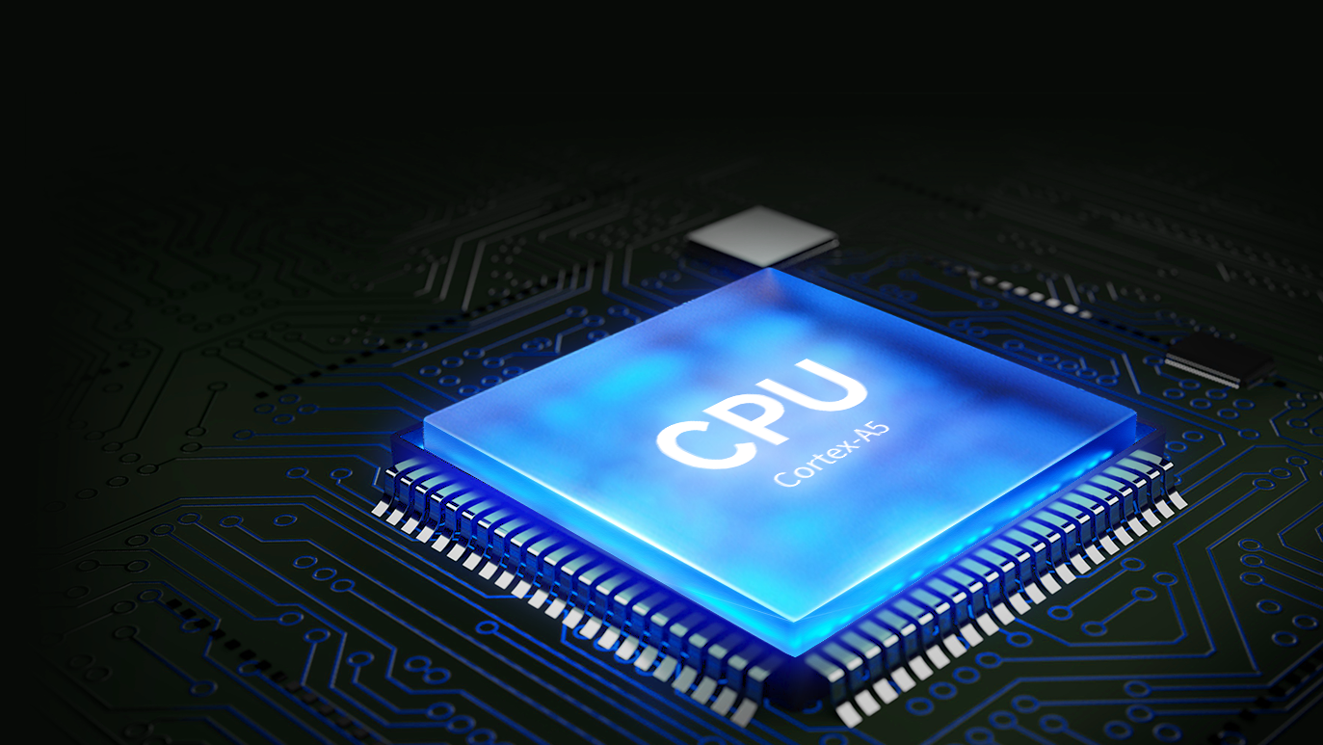
Incomparable Performance
The high-performance CPU of NEW6260 lets small and medium businesses deal with complicated operations flexibly and frictionless.

Slide 3
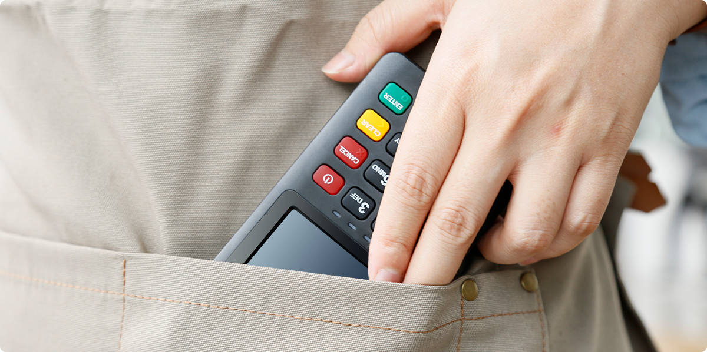
Easy Portability
NEW6260 is small and only weighs 145g for easy portability. E-signature displayed on a 2.4-inch colored touchscreen

Slide 4
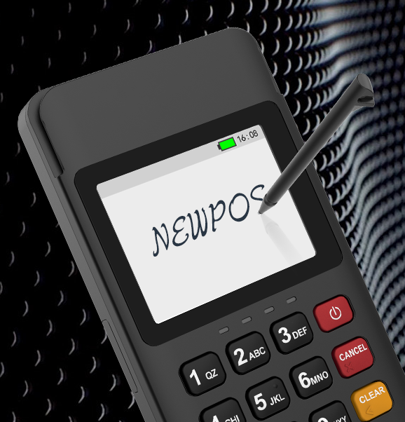
E-signature
The 2.4-inch color touch screen provides an optimal platform for the execution of signatures.

Slide 5
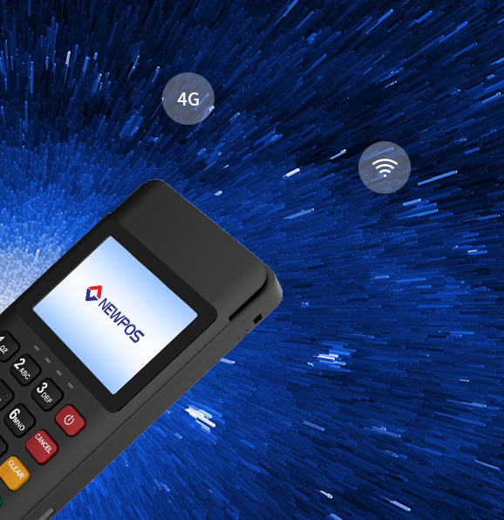
Multiple Reliable
Wireless Connections
NEW6260 comes with multiple communications options including：4G/2G/wifi. It can provide merchants with a small and various payment solution used in all interior and outer circumstances.

Slide 6
Enduring Power
NEW6260 can make 600 times transactions or standby 10 day on a single charge

Slide 7
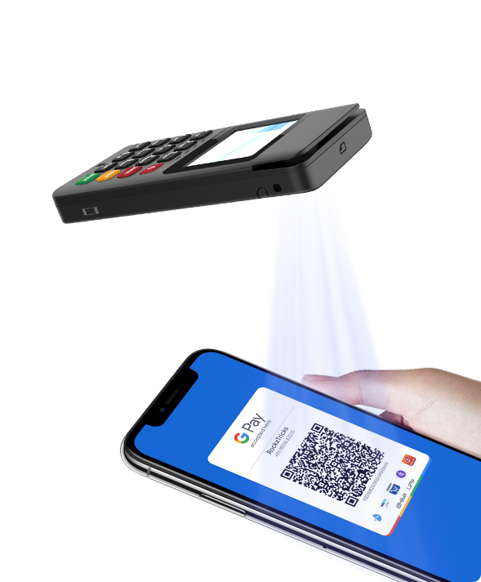
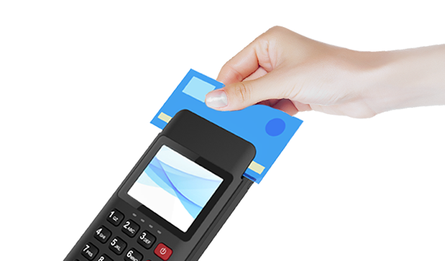
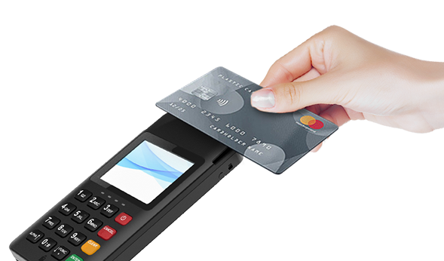
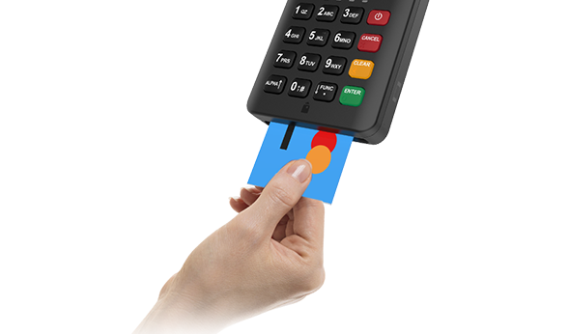
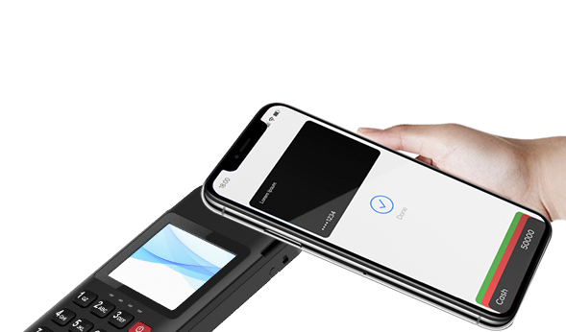
Supporting All Payments
It supports various payment methods, such as magnetic card, IC card, contactless transaction and code scanning transaction. A machine can be used for various forms, making collection simple.
1D / 2D QR
A magnetic card
NFC contactless
EMV chip & PIN
Apple pay & Google pay

Slide 8
NEW6260 Specifications
CPU | Cortex-A5 500MHz
Memory | FLASH: 16MB；SRAM: 16MB
Display | 2.4"LCD,320X240 pixels Resistive Touchscreen Supports e-signature
Keypad | 10 alphanumeric keys 5 function keys 1 power switch key
Card Reader | Magnetic Card Reader EMV Chip & PIN；NFC Contactless
Scanner | Optional，0.3MP Camera Support 1D &2D Code scanning
Card Slots | 1 x Nano SIM 2 x Nano SIM (optional) 1 x SAM(optional)
Communication | 4G(LTE)/2G(GPRS) Optional WiFi(2.4GHz)
Peripheral Ports | 1x Type-C USB2.0 Device
Battery | Rechargeable Liion battery 3.7V/800mAh
Adapter/ Power | Input: 100~240V AC,50Hz/60Hz Output:5V DC,1A
Dimensions | L×W×H (mm):136x69x17.5 Weight:145g
Audio | 1 × Buzzer
Storage Environment | Temperature: 20°C~60°C(-4°F~140°F) Humidity: 5%~95%(non-condense)
Working Environment | Temperature: 0°C~50°C(32°F~122°F) Humidity: 10%~90%(non-condense)
Certifications | PCIPTS 6.X,EMVL1&L2, EMV Contactless L1,Paypass, Paywave,American ExpressPay Discover D-PASAnatel,ABECS. CE,TQM,RoHS,etc.

